Slide 1
Unit -2
Entity–Relationship Data Model

Slide 2
Outline of Unit - 2
The Entity-Relationship (ER) Model
Entity types : Weak and strong entity sets
Entity sets
Types of Attributes,
Keys,
Relationship constraints
Cardinality and Participation
Extended Entity-Relationship (EER) Model
Generalization, Specialization and Aggregation

Slide 3
The Entity-Relationship (ER) Model
The ER model defines the conceptual view of a database. It works around real-world entities and the associations among them.
At view level, the ER model is considered a good option for designing databases.
An ER diagram shows the relationship among entity sets. An entity set is a group of similar entities and these entities can have attributes.

Slide 4
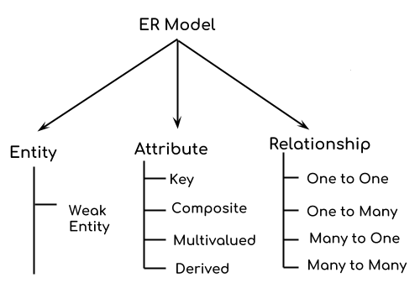
Components of a ER Diagram

Slide 5
The Entity-Relationship (ER) Model
ER Model is used to model the logical view of the system from data perspective which consists of these components:
1. Entity
2. Attribute
3. Relationship

Slide 6
The Entity-Relationship (ER) Model
1. Entity –
An entity is an object or component of data. An entity is represented as rectangle in an ER diagram.
An Entity may be an object with a physical existence – a particular person, car, house, or employee – or it may be an object with a conceptual existence – a company, a job, or a university course.

Slide 7
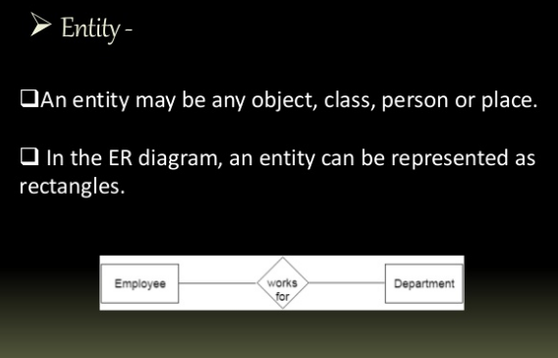
The Entity-Relationship (ER) Model
1. Entity –

Slide 8
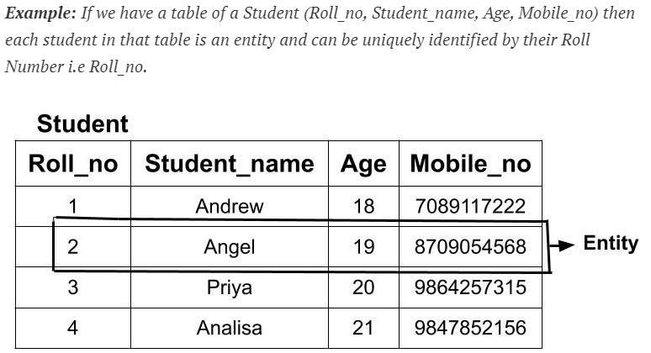
The Entity-Relationship (ER) Model
1. Entity –

Slide 9
The Entity-Relationship (ER) Model
2. Entity Set-
An entity set is a group of similar kind of entities.
It may contain entities with attribute sharing similar values.
Entities are represented by their properties, which also called attributes.

Slide 10
Entity Set -
Entity Set is a collection of entities of the same entity type.
In the above example of STUDENT entity type, a collection of entities from the Student entity type would form an entity set. We can say that entity type is a superset of the entity set as all the entities are included in the entity type. Let's try to understand this with the help of an example.
Example 1: In the below example, two entities E1 (2, Angel, 19, 8709054568) and E2(4, Analisa, 21, 9847852156) form an entity set.

Slide 11
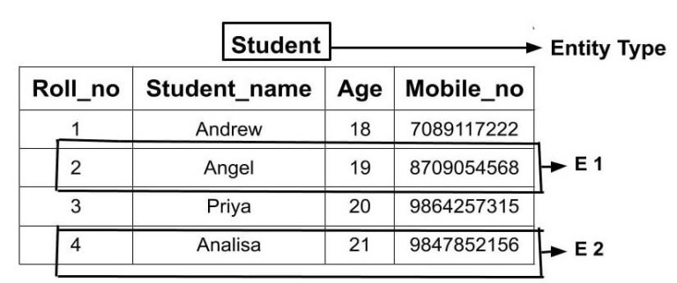
Entity Set

Slide 12
Entity Type
The entity type is a collection of the entity having similar attributes.
In the above Student table example, we have each row as an entity and they are having common attributes i.e each row has its own value for attributes Roll_no, Age, Student_name and Mobile_no.
So, we can define the above STUDENT table as an entity type because it is a collection of entities having the same attributes.

Slide 13
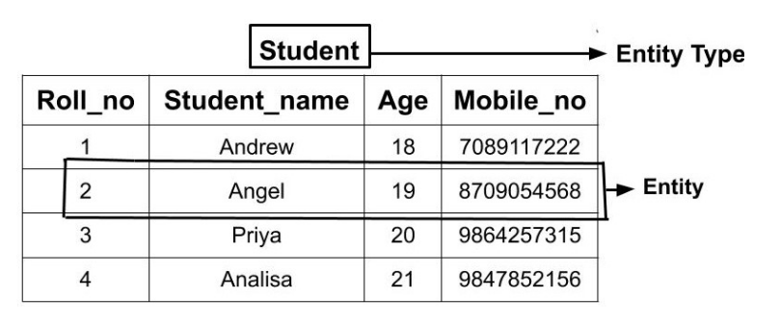
Entity Type
The table below shows how the data of different entities( different students) are stored.

Slide 14
Types of Entity type
1. Strong Entity Type
Strong entity are those entity types which has a key attribute.
The primary key helps in identifying each entity uniquely. It is represented by a rectangle.
2. Weak Entity Type
An entity that depends on another entity called as weak entity.
The Weak entity doesn't contain ant key attributes of its own.

Slide 15
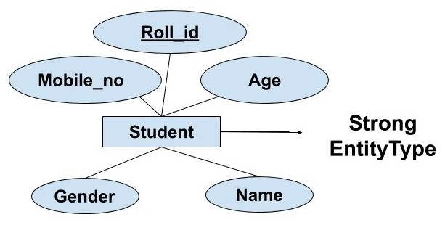
Strong Entity Type
In the above example, Roll_no identifies each element of the table uniquely and hence, we can say that STUDENT is a strong entity type.

Slide 16
Weak Entity Type
Weak entity type doesn't have a key attribute.
Weak entity type can't be identified on its own.
It depends upon some other strong entity for its distinct identity.

Slide 17
Weak Entity Type
Example:
If we have two tables of Customer(Customer_id, Name, Mobile_no, Age, Gender) and Address(Locality, Town, State, Customer_id). Here we cannot identify the address uniquely as there can be many customers from the same locality. So, for this, we need an attribute of Strong Entity Type i.e ‘Customer’ here to uniquely identify entities of 'Address' Entity Type.

Slide 18
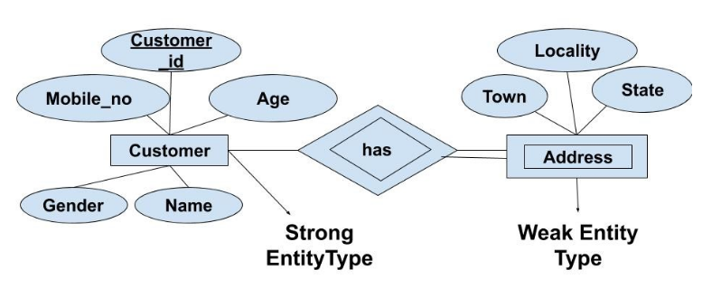
Weak Entity Type
Example:

Slide 19
Attributes
Entities are represented by means of their properties, called attributes.
All attributes have values.
For example, a student entity may have name, class, and age as attributes.

Slide 20
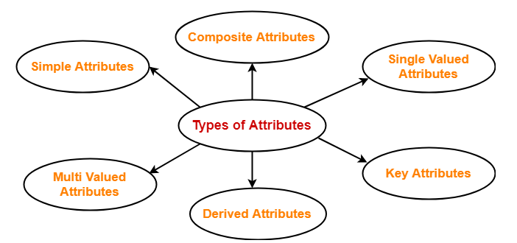
Attributes
In ER diagram, attributes associated with an entity set may be of the following types-

Slide 21
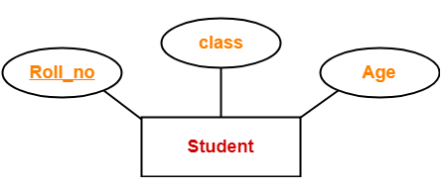
1. Simple Attributes-
Simple attributes are those attributes which can not be divided further.

Slide 22
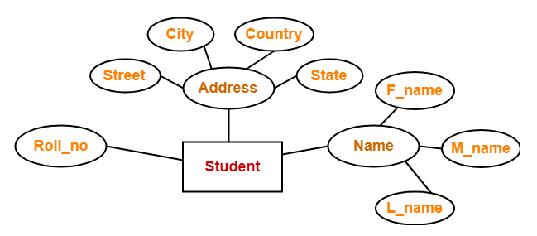
2. Composite Attributes-
Composite attributes are those attributes which are composed of many other simple attributes.

Slide 23
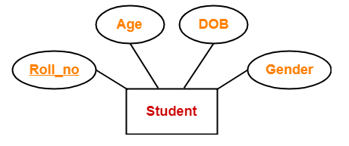
3. Single Valued Attributes-
Single valued attributes are those attributes which can take only one value for a given entity from an entity set.

Slide 24
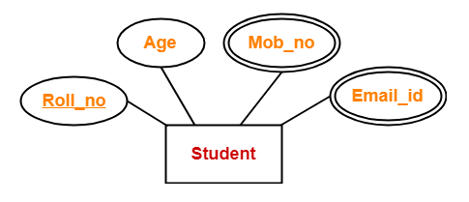
4. Multi Valued Attributes-
Multi valued attributes are those attributes which can take more than one value for a given entity from an entity set.

Slide 25
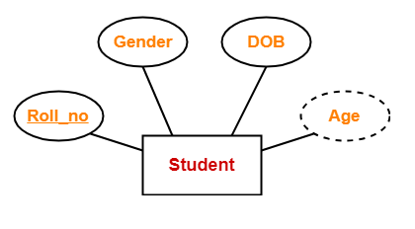
5. Derived Attributes-
Derived attributes are those attributes which can be derived from other attribute(s).

Slide 26
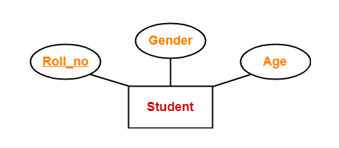
6. Key Attributes-
Key attributes are those attributes which can identify an entity uniquely in an entity set.
Key attributes are those attributes which can identify an entity uniquely in an entity set.

Slide 27
Relationship
Any association between two entity types is called a relationship. Entities take part in the relationship. It is represented by a diamond shape.
A relationship, in the context of databases, is a situation that exists between two relational database tables when one table has a foreign key that references the primary key of the other table.
Entities may have several relationships among themselves.

Slide 28
Relationship
Relationships allow relational databases to split and store data in different tables, while linking disparate data items.
Whenever an attribute of one entity refers to another entity, there exists a relationship between the two entities.

Slide 29
Relationship
Types of Relationship
Three types of relationship exist among entities. These are:
1. One-to-one
2. One-to-many
3. Many-to-many

Slide 30
Relationship
One-to-one(1:1) Relationship
A one-to-one (1:1) relationship is when at most one instance of a entity A is associated with one instance of entity B.
Such a relationship exists when each record of one table is related to only one record of the other table.

Slide 31
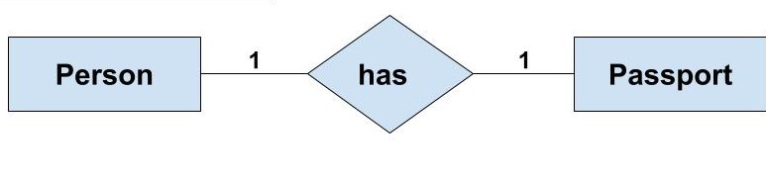
Relationship
One-to-one(1:1) Relationship
Example - If there are two entities ‘Person’ (Id, Name, Age, Address)and ‘Passport’(Passport_id, Passport_no). So, each person can have only one passport and each passport belongs to only one person.

Slide 32
Relationship
2. One-to-many (1:M) Relationship
A one-to-many (1:M) relationships is when for one instance of entity A, there are zero, one, or many instances of entity B, but for one instance of entity B, there is only one instance of entity A.
Such a relationship exists when each record of one table can be related to one or more than one record of the other table.
A one-to-many relationship can also be said as a many-to-one relationship depending upon the way we view it.

Slide 33
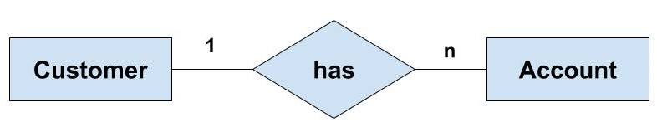
Relationship
2. One-to-many (1:M) Relationship
Example - If there are two entity type ‘Customer’ and ‘Account’ then each ‘Customer’ can have more than one ‘Account’ but each ‘Account’ is held by only one ‘Customer’. In this example, we can say that each Customer is associated with many Account. So, it is a one-to-many relationship.

Slide 34
Relationship
3. Many-to-many (M:M) Relationship
A many-to-many (M:M) relationship, sometimes called non-specific, is when for one instance of entity A, there are zero, one, or many instances of entity B and for one instance of entity B there are zero, one, or many instances of entity A.
Such a relationship exists when each record of the first table can be related to one or more than one record of the second table and a single record of the second table can be related to one or more than one record of the first table.

Slide 35
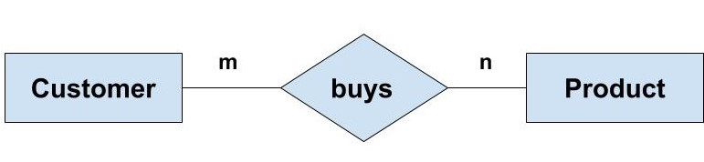
Relationship
3. Many-to-many (M:M) Relationship
Example: If there are two entity type ‘Customer’ and ‘Product’ then each customer can buy more than one product and a product can be bought by many different customers.

Slide 36
Relationship
3. Many-to-many (M:M) Relationship
A many-to-many (M:M) relationship, sometimes called non-specific, is when for one instance of entity A, there are zero, one, or many instances of entity B and for one instance of entity B there are zero, one, or many instances of entity A.
Such a relationship exists when each record of the first table can be related to one or more than one record of the second table and a single record of the second table can be related to one or more than one record of the first table.

Slide 37
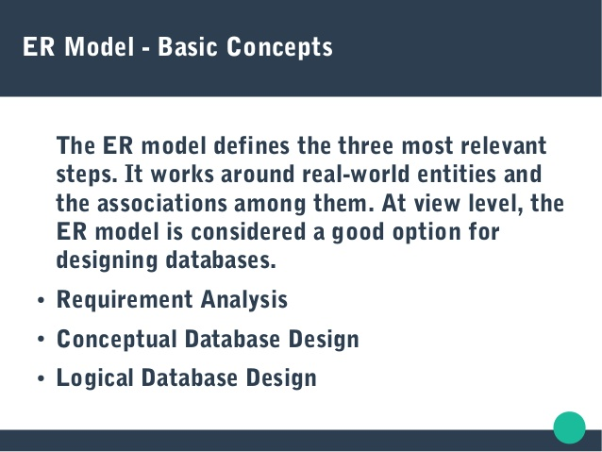

Slide 38
Entity-Relationship Model
Entity-Relationship Diagram (ERD) - can express the general logical structure of a database graphically.
It consist of following three components –
Entity
Attributes
Relationship

Slide 39
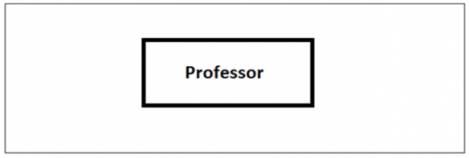
Entity-Relationship Model
Entity in DBMS can be a real-world object with an existence, For example, in a Company database, the entities can be Employees, Department, Project, etc. In a College database, the entities are Profession, Students, Result, Activities, etc.
An entity is represented as a single rectangle, shown below

Slide 40
The Entity-Relationship (ER) Model
Notations Used in ER- Model :
Rectangle: Represents Entity sets.
Ellipses: Attributes
Diamonds: Relationship Set
Lines: They link attributes to Entity Sets and
Entity sets to Relationship Set

Slide 41
The Entity-Relationship (ER) Model
Notations Used in ER- Model :
Double Ellipses: Multivalued Attributes
Dashed Ellipses: Derived Attributes
Double Rectangles: Weak Entity Sets
Double Lines: Total participation of an entity in
a relationship set

Slide 42
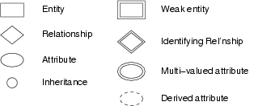
Entity-Relationship Model
Symbols used in ER Model-

Slide 43
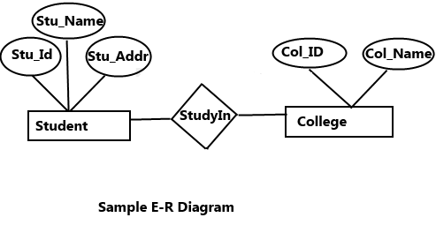
Entity-Relationship Model
Example of schema in the entity-relationship model -

Slide 44
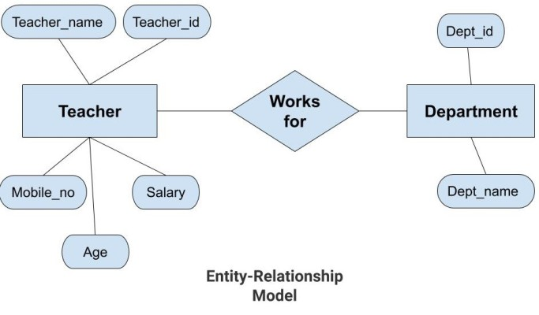
Entity-Relationship Model
Example of schema in the entity-relationship model -

Slide 45
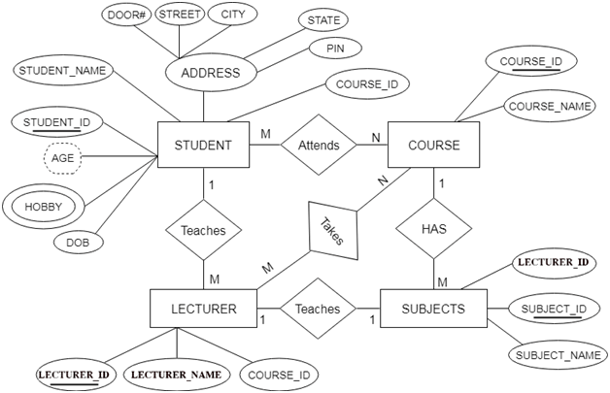

Entity-Relationship Model

Slide 46
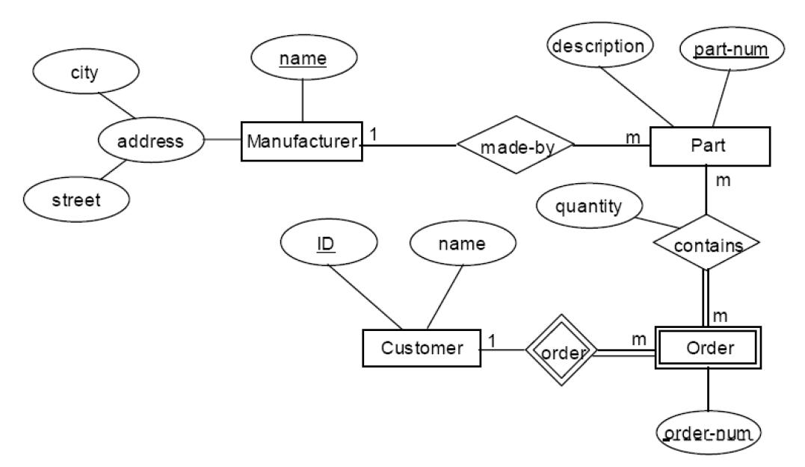
Entity-Relationship Model

Slide 47

Entity-Relationship Model
Example of schema in the entity-relationship model -

Slide 48
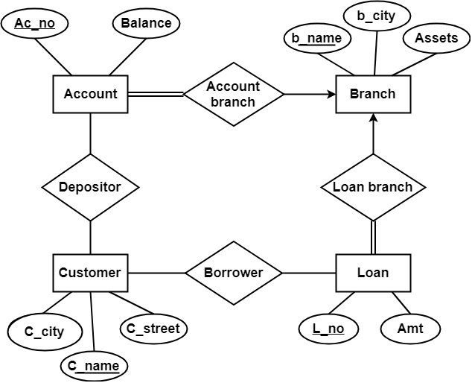
Entity-Relationship Model
Example of schema in the entity-relationship model -

Slide 49
KEYS in DBMS
KEYS in DBMS is an attribute or set of attributes which helps you to identify a row(tuple) in a relation(table).
They allow you to find the relation between two tables.
Keys help you uniquely identify a row in a table by a combination of one or more columns in that table.

Slide 50
Why we need a Key?
Keys help you to identify any row of data in a table. In a real-world application, a table could contain thousands of records. Moreover, the records could be duplicated. Keys ensure that you can uniquely identify a table record despite these challenges.
Allows you to establish a relationship between and identify the relation between tables
Help you to enforce identity and integrity in the relationship.

Slide 51
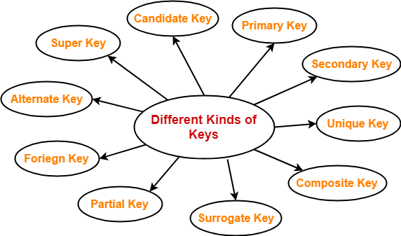
Types of Keys in Database Management System

Slide 52
Primary Key
Primary Key - is a column or group of columns in a table that uniquely identify every row in that table.
Rules for defining Primary key:
Two rows can't have the same primary key value
It must for every row to have a primary key value.
The primary key field cannot be null.
The value in a primary key column can never be modified or updated if any foreign key refers to that primary key.

Slide 53
Primary Key
For Example, STUD_NO, as well as STUD_PHONE both, are candidate keys for relation STUDENT but STUD_NO can be chosen as the primary key (only one out of many candidate keys).

Slide 54
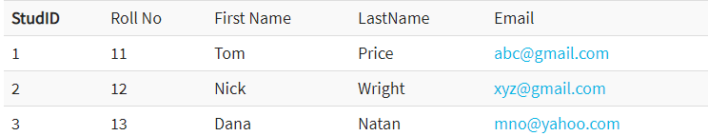
Primary Key
Example:
In the following example, StudID is a Primary Key.

Slide 55
Secondary Key
Secondary Key - Only one of the candidate keys is selected as the primary key. The rest of them are known as secondary keys.

Slide 56
Foreign key
FOREIGN KEY is a column that creates a relationship between two tables.
The purpose of Foreign keys is to maintain data integrity and allow navigation between two different instances of an entity. It acts as a cross-reference between two tables as it references the primary key of another table.
This concept is also known as Referential Integrity.

Slide 57
Foreign key
Example:
In the following example, Roll_no is a Primary Key.
Student Course
R_no | Name | Adress
1 | A | Mumbai
2 | B | Pune
3 | C | Goa
4 | D | Delh
- | -
C_id | C_name | R_no
C1 | DMS | 1
C2 | MP | 2
C3 | CN | 3

Slide 58
Super Key
Super Key- A super key is a group of single or multiple keys which identifies rows in a table. A Super key may have additional attributes that are not needed for unique identification.
R_no | Name | Adress | Phone_no
1 | A | Mumbai | 88555555262
2 | B | Pune | 9865325241
3 | C | Goa | 8956231478
4 | D | Delh | 9632587412

Slide 59
Super Key
Name | Marks | Dept | Course
A | 70 | CE | C1
B | 60 | IT | C1
A | 70 | CE | C2
B | 90 | IT | C3
c | 80 | EE | C1

Slide 60
Super Key
U_id | Name | Marks | Dept | Course
1 | A | 70 | CE | C1
2 | B | 60 | IT | C1
3 | A | 70 | CE | C2
4 | B | 90 | IT | C3
5 | c | 80 | EE | C1

Slide 61
Candidate Key
CANDIDATE KEY is a set of attributes that uniquely identify tuples in a table.
Candidate Key is a super key with no repeated attributes. The Primary key should be selected from the candidate keys.
Every table must have at least a single candidate key. A table can have multiple candidate keys but only a single primary key.

Slide 62
Candidate Key
Properties of Candidate key:
It must contain unique values
Candidate key may have multiple attributes
Must not contain null values
It should contain minimum fields to ensure uniqueness
Uniquely identify each record in a table

Slide 63
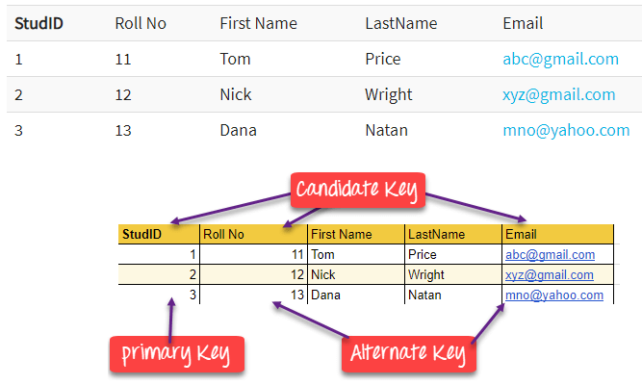
Candidate Key
Example: In the given table Stud ID, Roll No, and email are candidate keys which help us to uniquely identify the student record in the table.

Slide 64
Candidate Key
Candidate Key is a set of attributes that uniquely identify tuples in a table.
Candidate Key is a super key with no repeated attributes. The Primary key should be selected from the candidate keys.
Every table must have at least a single candidate key.
A table can have multiple candidate keys but only a single primary key.

Slide 65
Candidate Key
Properties of Candidate key:
It must contain unique values
Candidate key may have multiple attributes
Must not contain null values
It should contain minimum fields to ensure uniqueness
Uniquely identify each record in a table

Slide 66
Candidate Key
Properties of Candidate key:
It must contain unique values
Candidate key may have multiple attributes
Must not contain null values
It should contain minimum fields to ensure uniqueness
Uniquely identify each record in a table

Slide 67
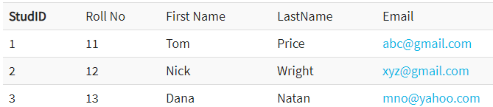
Candidate Key
Example: In the given table Stud ID, Roll No, and email are candidate keys which help us to uniquely identify the student record in the table.

Slide 68
Alternate Key
ALTERNATE KEYS is a column or group of columns in a table that uniquely identify every row in that table.
A table can have multiple choices for a primary key but only one can be set as the primary key.
All the keys which are not primary key are called an Alternate Key.

Slide 69
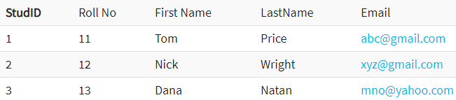
Alternate Key
Example:
In this table, StudID, Roll No, Email are qualified to become a primary key. But since StudID is the primary key, Roll No, Email becomes the alternative key.

Slide 70
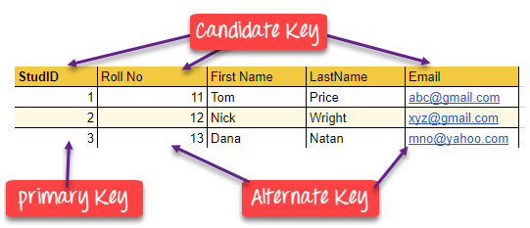

Slide 71
Compound key
COMPOUND KEY has two or more attributes that allow you to uniquely recognize a specific record.
It is possible that each column may not be unique by itself within the database.
However, when combined with the other column or columns the combination of composite keys become unique.
The purpose of the compound key in database is to uniquely identify each record in the table.

Slide 72
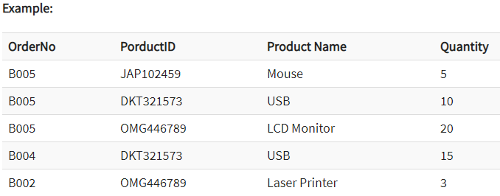
Compound key
In this example, OrderNo and ProductID can't be a primary key as it does not uniquely identify a record. However, a compound key of Order ID and Product ID could be used as it uniquely identified each record.

Slide 73
Composite Key
COMPOSITE KEY is a combination of two or more columns that uniquely identify rows in a table.
The combination of columns guarantees uniqueness, though individually uniqueness is not guaranteed.
Hence, they are combined to uniquely identify records in a table.

Slide 74
Composite Key
The difference between compound and the composite key is that any part of the compound key can be a foreign key, but the composite key may or maybe not a part of the foreign key.

Slide 75
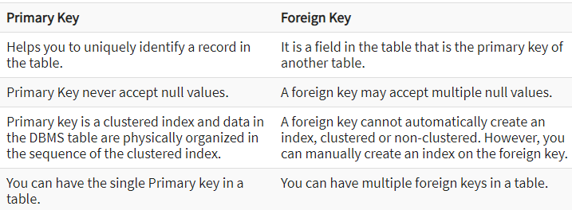
Difference Between Primary key & Foreign key

Slide 76
Unique Key
A unique key is a set of one or more than one fields/columns of a table that uniquely identify a record in a database table.
You can say that it is little like primary key but it can accept only one null value and it cannot have duplicate values.
The unique key and primary key both provide a guarantee for uniqueness for a column or a set of columns.

Slide 77
Unique Key
Properties of Unique key
Unique in nature
Not updatable
Null

Slide 78
Surrogate Key
Surrogate Key is An artificial key which aims to uniquely identify each record is called a surrogate key. This kind of partial key in dbms is unique because it is created when you don't have any natural primary key. They do not lend any meaning to the data in the table. Surrogate key is usually an integer. A surrogate key is a value generated right before the record is inserted into a table.

Slide 79
Surrogate Key
Properties of Surrogate Key
Unique in nature
Updatable
Not Null

Slide 80
Partial key
A partial key means just part of a key - some proper subset of the key attributes.
Employee
Dependent
Employee
Emp-no | Emp_Name | Age | Sex
001 | Ram | 20 | Male
002 | Rohit | 35 | Male
003 | Reena | 30 | Female
Emp _no | Dependance name | Relation
001 | Meera | Mother
001 | Sham | Brother
001 | Arnav | Son

Slide 81
Extended ER Model
EER is a high-level data model that incorporates the extensions to the original ER model.
Enhanced ERD are high level models that represent the requirements and complexities of complex database.

Slide 82
Extended ER Model
The enhanced entity–relationship (EER) model (or extended entity–relationship model) is a high-level or conceptual data model incorporating extensions to the original entity- relationship (ER) model, used in the design of databases.
EER model includes EER diagrams that are conceptual models that accurately represent the requirements of complex databases.

Slide 83
Features of EER Model
EER creates a design more accurate to database schemas.
It reflects the data properties and constraints more precisely.
It includes all modeling concepts of the ER model.
Diagrammatic technique helps for displaying the EER schema.
It includes the concept of specialization and generalization.
It is used to represent a collection of objects that is union of objects of different entity types.

Slide 84
Extended ER Model
In addition to ER model concepts EE-R includes −
1. Subclasses and Super classes.
2. Specialization and Generalization.
3. Category or union type.
4. Aggregation.

Slide 85
Extended ER Model
Super Class
Super class is an entity type that has a relationship with one or more subtypes.
An entity cannot exist in database merely by being member of any super class.
Example: Shape super class is having sub groups as Square, Circle, Triangle.

Slide 86
Extended ER Model
Sub Class
Sub class is a group of entities with unique attributes.
Sub class inherits properties and attributes from its super class.
Example: Square, Circle, Triangle are the sub class of Shape super class.

Slide 87
Extended ER Model
Category or Union
Category represents a single super class or sub class relationship with more than one super class.
It can be a total or partial participation.
For example Car booking, Car owner can be a person, a bank (holds a possession on a Car) or a company. Category (sub class) → Owner is a subset of the union of the three super classes → Company, Bank, and Person. A Category member must exist in at least one of its super classes.

Slide 88
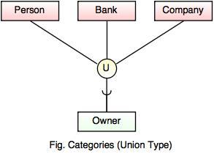
Extended ER Model
Category or Union -

Slide 89
Extended ER Model
Specialization
Specialization is a process that defines a group entities which is divided into sub groups based on their characteristic.
It is a top down approach, in which one higher entity can be broken down into two lower level entity.
It maximizes the difference between the members of an entity by identifying the unique characteristic or attributes of each member.

Slide 90
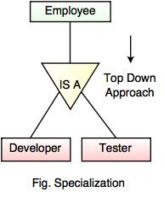
Extended ER Model
Specialization
It defines one or more sub class for the super class and also forms the superclass/subclass relationship.

Slide 91
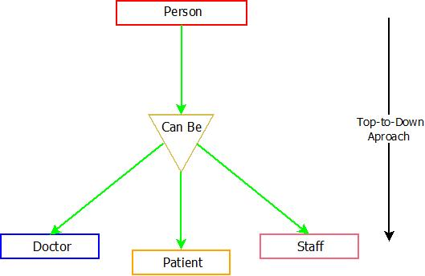
Extended ER Model
Specialization
Example-

Slide 92
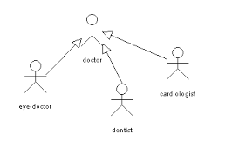
Extended ER Model
Specialization
Example-

Slide 93
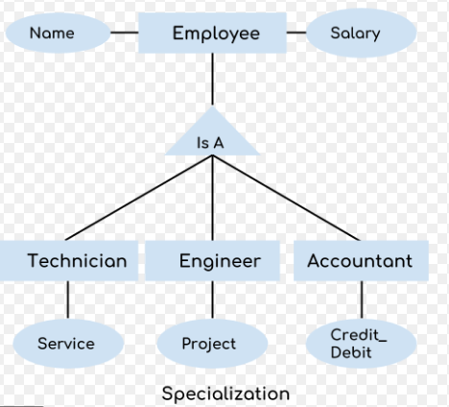
Extended ER Model
Specialization
Example-

Slide 94
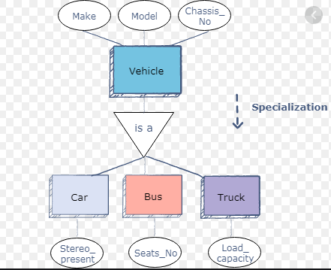
Extended ER Model

Slide 95
Extended ER Model
Generalization
Generalization is the process of generalizing the entities which contain the properties of all the generalized entities.
It is a bottom approach, in which two lower level entities combine to form a higher level entity.
Generalization is the reverse process of Specialization.
It minimizes the difference between the entities by identifying the common features.

Slide 96
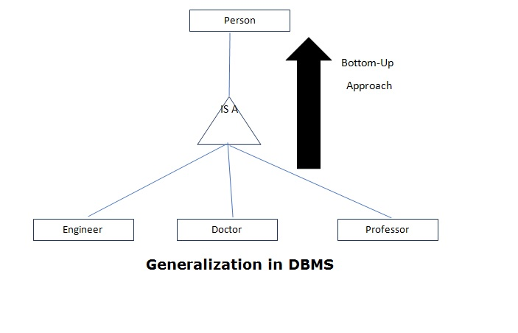
Extended ER Model
Generalization

Slide 97
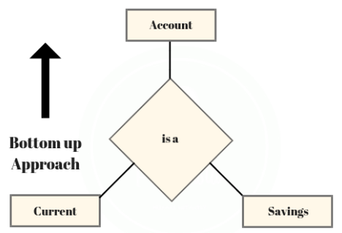
Extended ER Model
Generalization
Example:

Slide 98
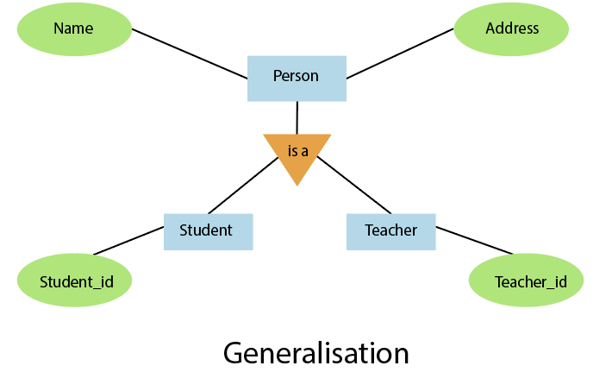
Extended ER Model
Generalization
Example:

Slide 99
Extended ER Model
Aggregation
Aggregation is a process that represent a relationship between a whole object and its component parts.
It abstracts a relationship between objects and viewing the relationship as an object.
It is a process when two entity is treated as a single entity.

Slide 100
Extended ER Model
Aggregation
In this example, the relation between College and Course is acting as an Entity in Relation with Student.

Slide 101
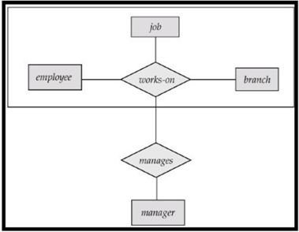
Extended ER Model
Aggregation -
Example:

Slide 102
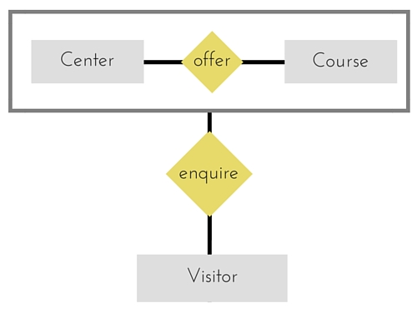
Extended ER Model
Aggregation -
Example:

Slide 103
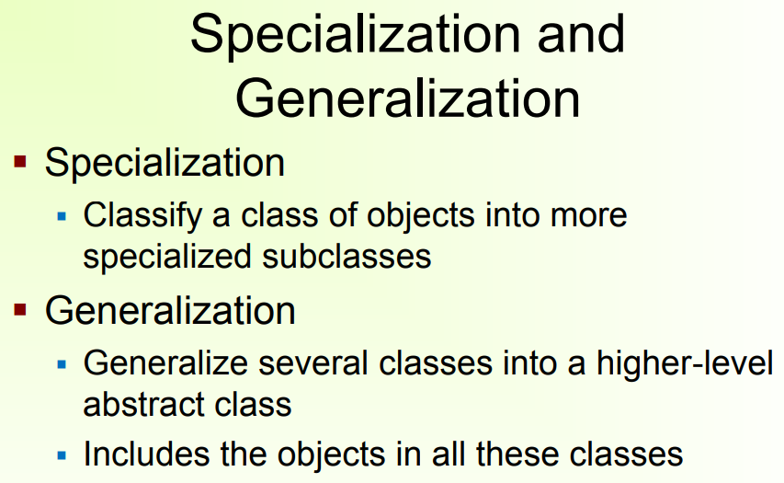

Slide 104
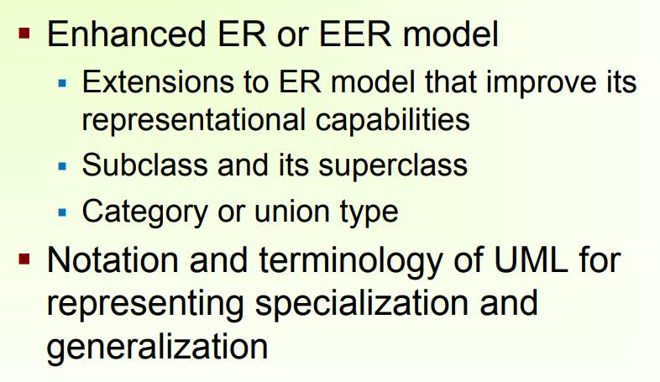

Slide 105
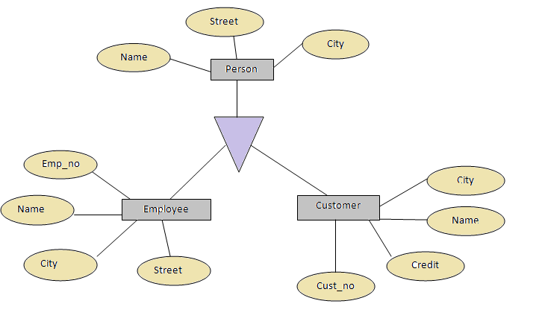
Extended ER Model

Slide 106
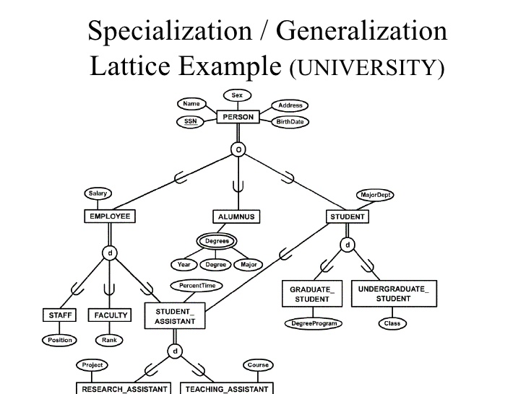
Extended ER Model

Slide 107
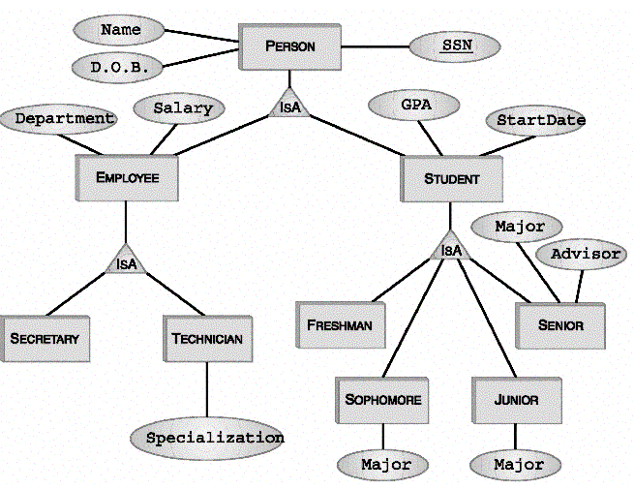
Extended ER Model

